Slide 1
Credit Card Approval
By: Krit Patel

Slide 2
Who is this information useful to?
Applicants seeking insight on credit card approval based on their finances.
Management to evaluate the business model.

Slide 3

The source of this dataset is from Kaggle belonging to a UCI Machine Learning Repository.
Dataset contains information regarding Credit Card Applicants and whether or not they got approved.
DATA SOURCE:
Source link

Slide 4
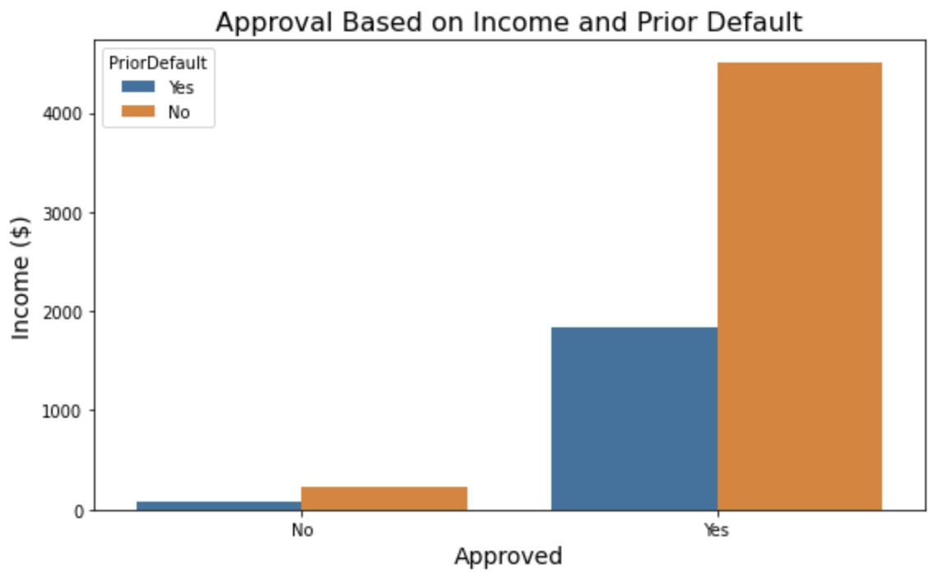
Data Visualization
This barchart indicates that on average an income of $ 500 or more qualifies an applicant for a credit card regardless of their default status.

Slide 5
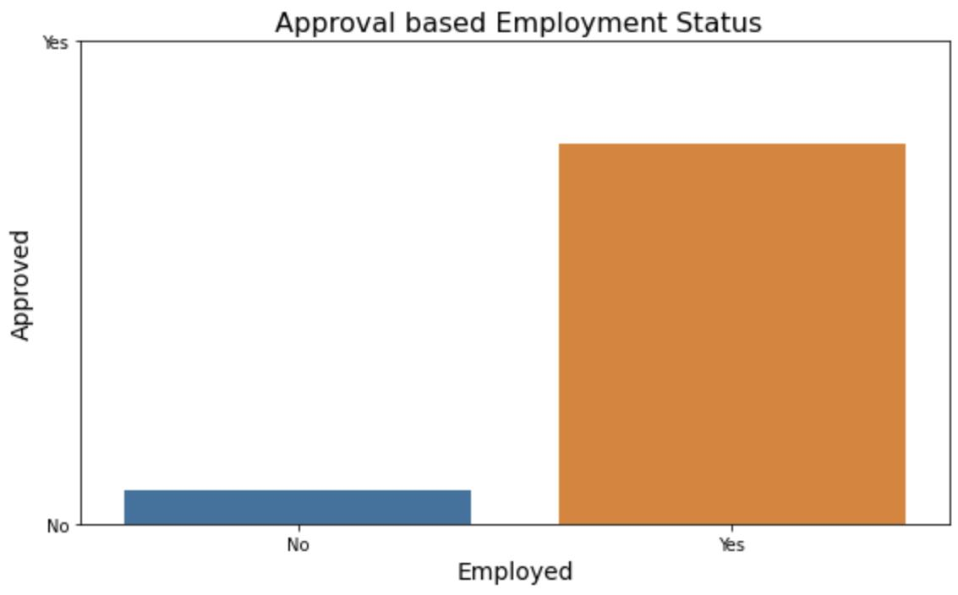
Data Visualization
This barchart shows us that on average applicants that are employed are more likely to be approved compared to those who are not.

Slide 6
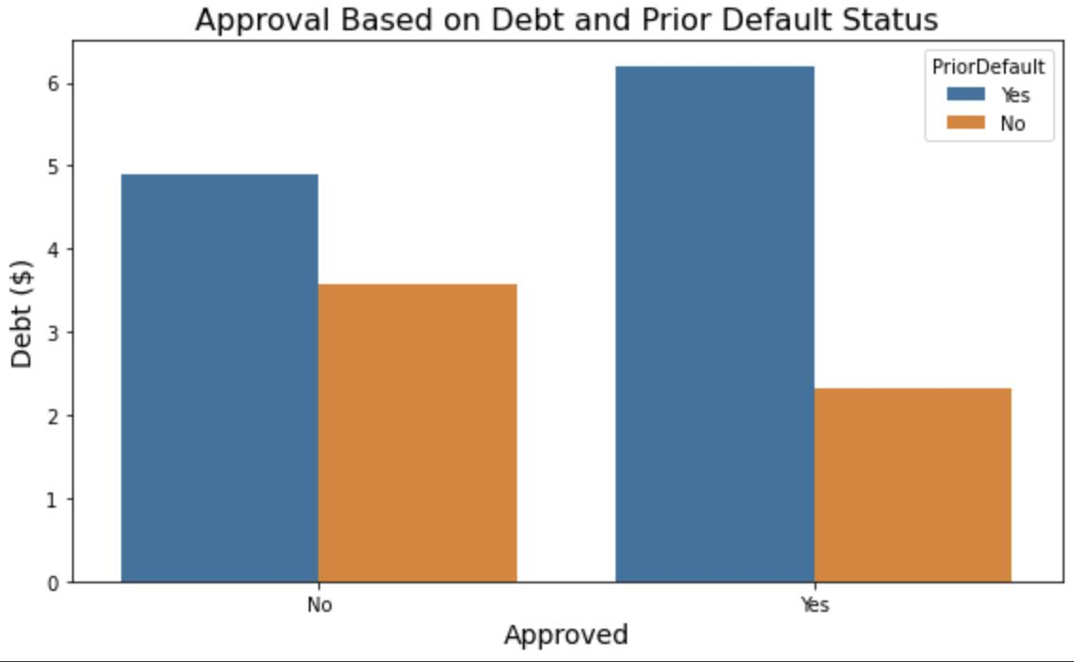
Data Visualization
This barchart shows us that regardless of whether or not an applicant got approved, the debt of applicants with a prior default is on average significantly higher than those without a prior default.

Slide 7
Prediction Model Evaluation
Class Balance: 44% of applicants being approved and 56% of applicants
being denied.
The model predicts whether or not a person got approved with 85% accuracy.
Error of 15%
7% of the predictions from the model are that an applicant did not get approved when they got approved.
8% of the predictions from the model are that an applicant got approved when they did not get approved.

Slide 8
Next Steps:
Keep improving the model.
Try different models.
Adding more data would help improve accuracy of this model.

Slide 9
Final Recommendations:
For applicants seeking for a credit card, being employed with an income above $ 500 would improve the chances of being approved.
Management should look into the strategies to avoid a future default of applicants with high debt and a history of prior default.

Slide 10
Contact Info:
Email: kritp144@gmail.com
LinkedIn: Krit Patel

